Slide 1

Alert Watch and Response Engine (AWARE)
Alert Viewer Training
Ralph H Johnson VA Medical Center
Charleston, SC
June 2014
CLIN 0009AC

Slide 2
Contents
Lesson 1: What Is the Alert Viewer?
Overview
User Access Levels
Lesson 2: Using the Alert Viewer
Logging In and Out
Viewing Data
Navigating Through the Data
Filtering Data
Sorting Data
Viewing Detailed Data About an Alert
Contact Information

Slide 3
Purpose and Objectives
Objective: To provide an overview, basic training, and examples of how to access and use the Alert Viewer
After completing this training:
All users should be able to access and navigate the Alert Viewer to view information about critical alerts.

Slide 4
Lesson 1: What Is the Alert Viewer?

Slide 5
Overview
The Alert Viewer is a web-based tool for viewing data regarding the past 30 days worth of critical alerts.
Primary users:
Clinicians
Additional potential users:
Patient Safety Officers
Care Team Leads

Slide 6
User Access Levels
“Normal” User:
Clinicians who are able to view only their own alert data from the past 30 days
User with “VEFA AWARE ALL ALERT CACHE” security key:
Users who are able to view all clinicians’ alert data from the past 30 days
Note: It is the responsibility of the Clinical Application Coordinators (CACs) or administrators to assign users with the appropriate key.

Slide 7
Lesson 2: Using the Alert Viewer

Slide 8
Logging In and Out

Slide 9
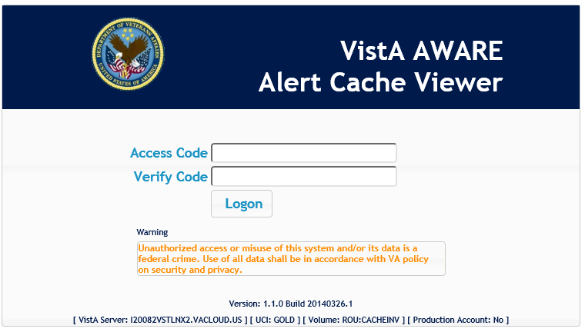
Logging In
Open a web browser and navigate to [URL].
You should then see the page below:
Alert Viewer Login Page

Slide 10
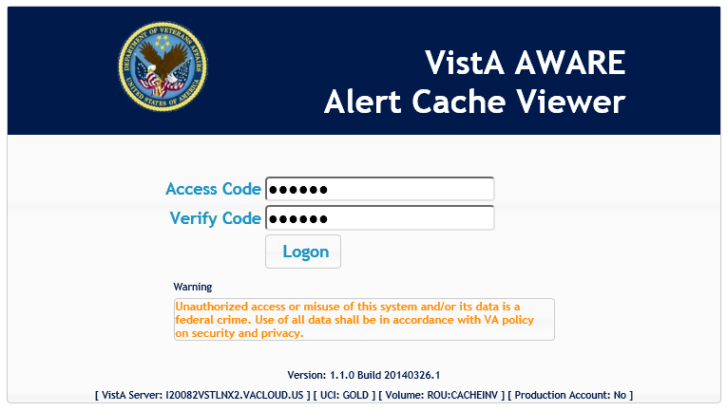
Logging In
Type your CPRS Access and Verify Codes into the fields.
Alert Viewer Login Page

Slide 11
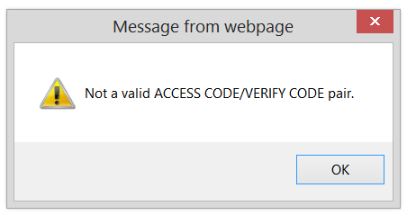
Logging In
Click Logon.
Note: If your login information is incorrect, you will see the following message. If this occurs, click OK and try entering your login information again or contact your administrator.
Alert Viewer Login Page
Logon Error Message

Slide 12
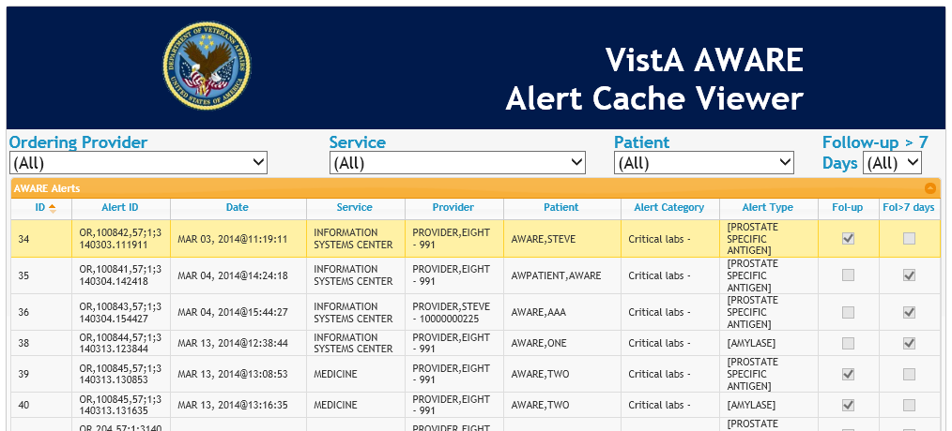
Logging In
Upon successfully logging in, you should see this page.
Alert Viewer Main Page

Slide 13
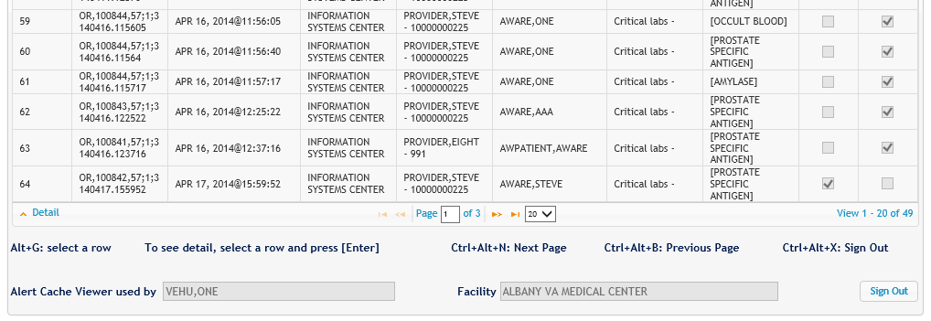
Logging Out
To log out, click the Sign Out button in the bottom-right of the page or press Ctrl+Alt+X.
Alert Viewer Page

Slide 14
Viewing Data

Slide 15
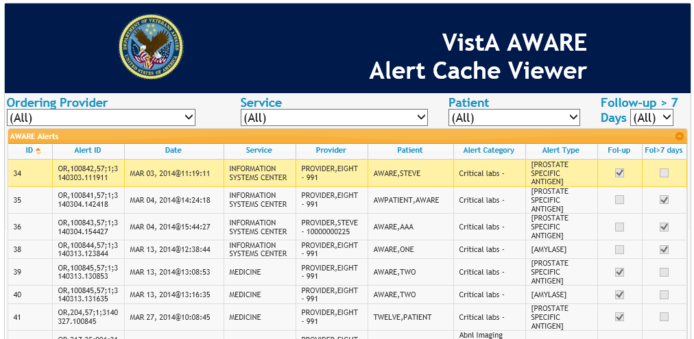
The Alert Viewer
The Alert Cache shows a list of critical alerts created within the past 30 days.
Alert Viewer Main Page

Slide 16
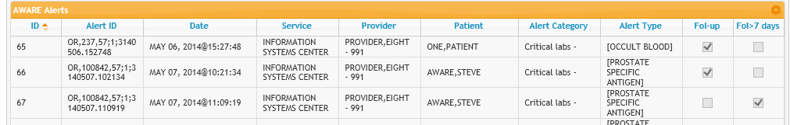
Understanding the Columns
Each of the columns in the table shows data about the alert
The alert’s ID for tracking
Where the alert was created
Alert IDs used for tracking
Date the alert was generated
Have more than 7 days passed without follow-up?
Provider who received the alert
Name of patient
Category of alert
Type of alert
Has follow-up been performed?

Slide 17
The Alert Viewer Main Page
In the Alert Viewer, you can:
Navigate between pages of data and change how much data is displayed on a page
Filter the data to show only subsets
Sort the data in different orders
See detailed information about a specific alert
Each of these functions will be explained in the subsequent slides.

Slide 18
Navigating Through THE Data

Slide 19
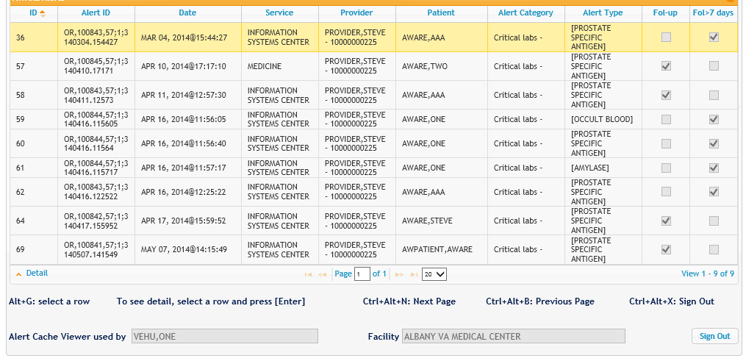
Navigating Through Data
The navigation controls at the bottom of each page allow you to navigate between pages and change how much data is displayed on a page.
Alert Viewer Page

Slide 20

Navigation Controls
Go to the first page of data
Go back one page
Type a number in this field and press Enter to move directly to that page
Go forward one page
Go to the last page of data
Click to display a dropdown to choose how many records are displayed on a page

Slide 21
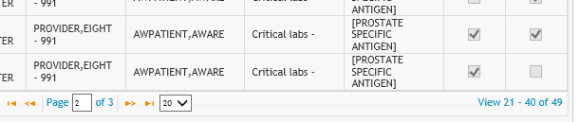
View Records Display
Text at the bottom of the screen shows which alert data records you are currently viewing.
For example, records 21-40 of 49 total records
Alert Viewer View Records Display

Slide 22
Filtering Data

Slide 23
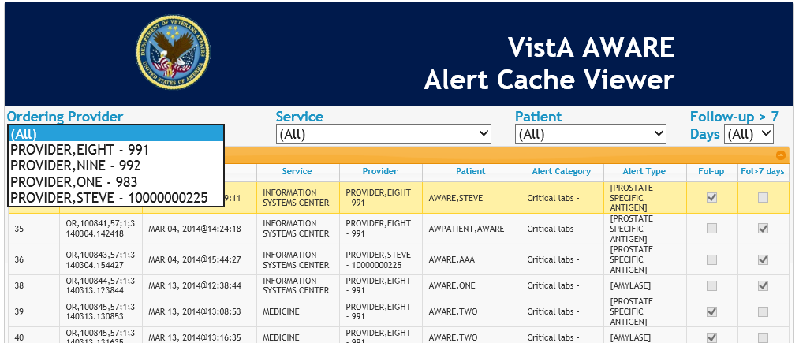
Selecting a Provider
Use the Ordering Provider dropdown to select which provider’s alerts to view.
Note: Unless you have the “VEFA AWARE ALL ALERT CACHE” security key, you can only view your own alerts.
Alert Viewer Main Page

Slide 24
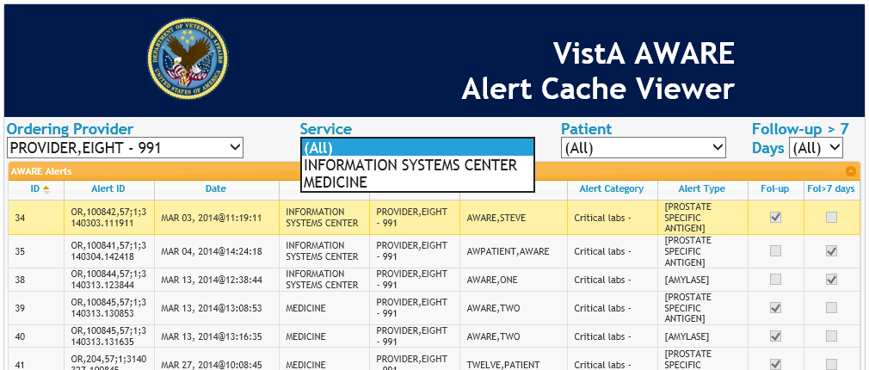
Selecting a Service
Use the Service dropdown to view alerts for a particular service.
Alert Viewer showing Provider Eight’s alerts

Slide 25
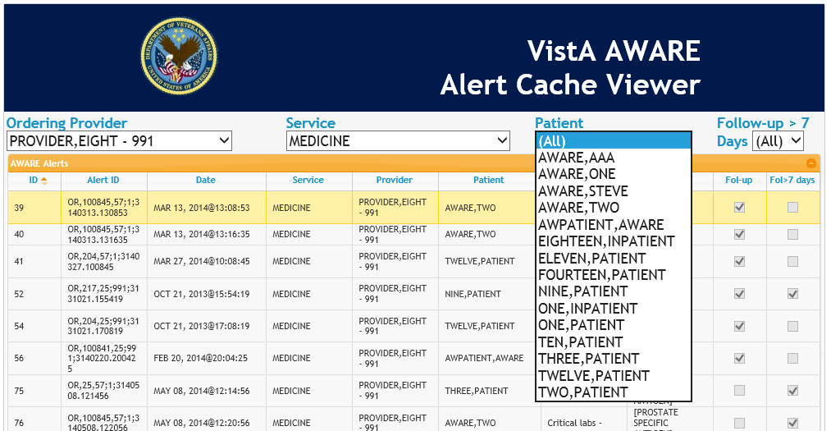
Selecting a Patient
Use the Patient dropdown to view alerts for a particular patient.
Alert Viewer showing Provider Eight’s medicine alerts

Slide 26
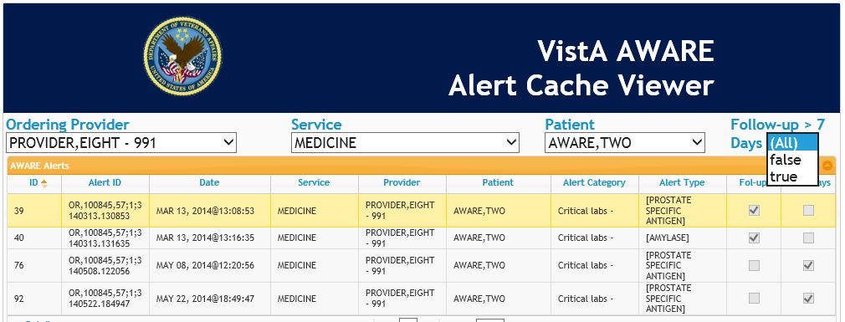
Selecting Alerts Based on Follow-up Status
Use the Follow-up > 7 days dropdown to filter alerts based on their follow-up status.
True: More than 7 days have passed since the generation of this alert and no follow-up has been posted yet.
False: Either follow-up was posted within 7 days or 7 days have not yet passed since the generation of this alert.
Alert Viewer showing Provider Eight’s Medicine alerts for patient “Two AWARE”

Slide 27
Sorting Data

Slide 28
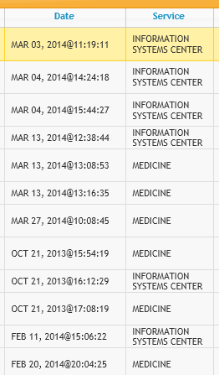
Sorting Data
Click on a column header to sort all of the data according to that column.
For example, chronologically from most recent to least recent.
Click on the same column header again to sort all data in the opposite direction.
For example, reverse chronologically from least recent to most recent.
Data sorted chronologically by alert generation date

Slide 29
Viewing Detailed Data

Slide 30
Viewing Detailed Data
Double-click a row or press Enter on a highlighted row to view detailed data about that alert.
Alert Viewer Page

Slide 31
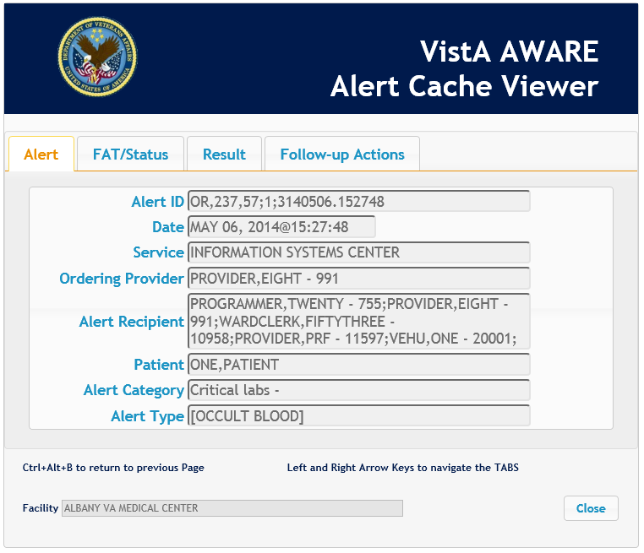
Viewing Detailed Data
You will then see the Alert Detail Page with tabs where you can view detailed information about that alert.
Alert Viewer Alert Detail Page

Slide 32
Alert Tab
The Alert tab shows information about the alert itself, such as its category, type, ordering provider, and when it was created.
Alert ID | The Alert Tracking Name field
Date | The date and time the alert was created
Service | The name of the service or section for the Alert Recipient
Ordering Provider | The provider who generated the alert
Alert Recipient | The recipient(s) of the alert, such as the Ordering Provider, Lab Tech, Radiologist, or OR/RR Team
Patient | The Patient name indicated by the Alert
Alert Category | The Alert Category, which determines the notification type
Alert Type | The Alert Type name stored in Alert Display Text
Alert Viewer Alert Detail Page – Alert Tab

Slide 33
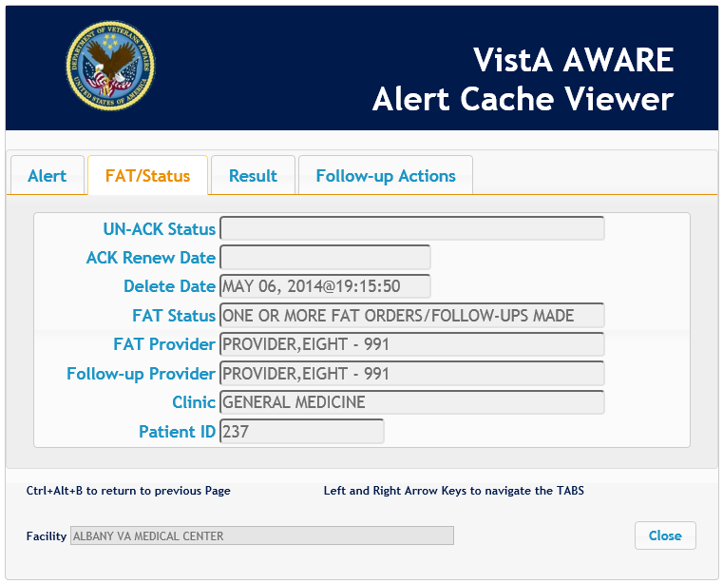
FAT/Status Tab
The FAT/Status tab shows information from the Follow-up Actions Tracker (FAT), such as whether follow-up action was taken on this alert.
UN_ACK Status | Indicates whether or not the Alert has a Processed Alert Date and Deleted Date.
ACK Renew Date | This date identifies the renewed date for needed acknowledgement after no follow-up action taken has been determined upon provider processing of the alert.
Delete Date | The Alert Deleted Date (date of acknowledgement)
FAT Status | This field indicates whether FAT Orders/Follow-ups have been made.
FAT Provider | If FAT Orders/Follow-ups have been made, this field will contain the provider who did the required follow-up action(s) defined for this alert type.
Follow-up Provider | The provider who performed follow-up action(s) on the alert, not necessarily the same person as the ordering provider
Clinic | The hospital location from which the order originated
Patient ID | The Patient DFN indicated by the alert
Alert Viewer Alert Detail Page – FAT/Status

Slide 34
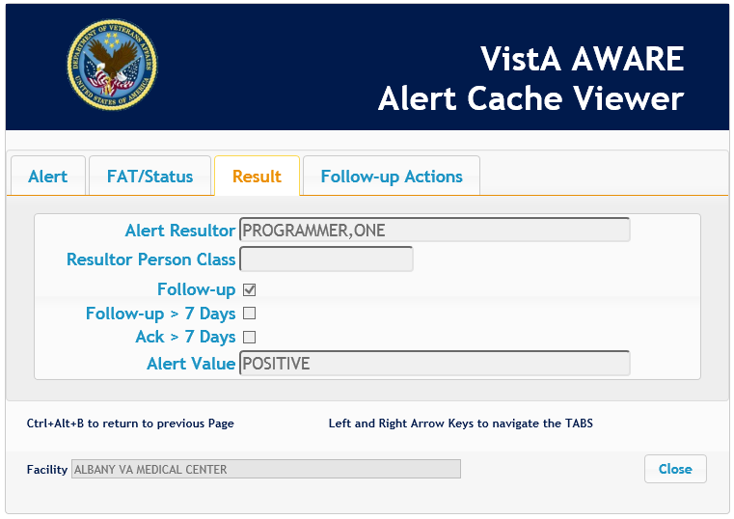
Result Tab
The Result tab shows additional information about follow-up actions, such as whether follow-up is still missing after more than 7 days.
Alert Resultor | The person responsible for the Alert being created
Resultor Person Class | The person class of who created the alert( lab tech, radiologist, etc.)
Alert Type Orig Station | The site number of the VA facility where the Alert Type was created
Follow-up | Indicates whether or not follow-up action(s) have been performed for this alert
Follow-up > 7 Days | A check here means more than 7 days have passed since the alert was made and no follow-up has been posted
Ack > 7 Days | This field indicates whether or not the date of acknowledging the alert is past 7 days from generation
Alert Value | Indicates the actual value of the alert (abnormal, positive, etc.)
Alert Viewer Alert Detail Page – Result Tab

Slide 35
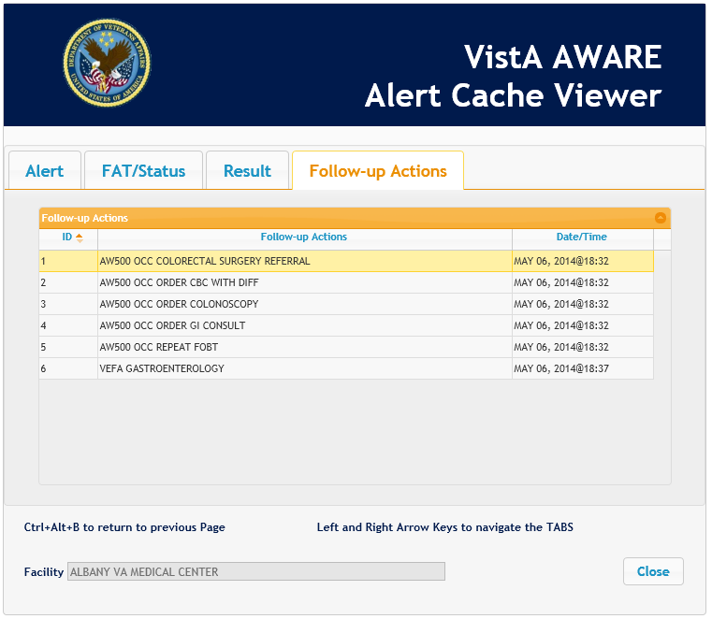
Follow-Up Actions Tab
The Follow-up Actions tab shows all follow-up actions and orders for this alert, and the dates they were performed.
Alert Viewer Alert Detail Page – Follow-up Actions Tab

Slide 36
Contact Information

Slide 37
Contact Information
If you have questions or need additional assistance, contact:
CAC Support:
Margaret Fralin (Margaret.Fralin@va.gov)
Patrick McGillicuddy (Patrick.McGillicuddy@va.gov)
AWARE Technical Support:
awarespprt@gmail.com

